Slide 1

Matrix

Slide 2
Table Contents
Definition
Introduction
Matrix Operations
Application of Matrix
Types of Matrix
Conclusion
2
Notes:
SAY: Before we wrap up the course, let’s review what we have learned today.
During this course, we have
<READ the bullets from the slide.>
GO to next slide.

Slide 3
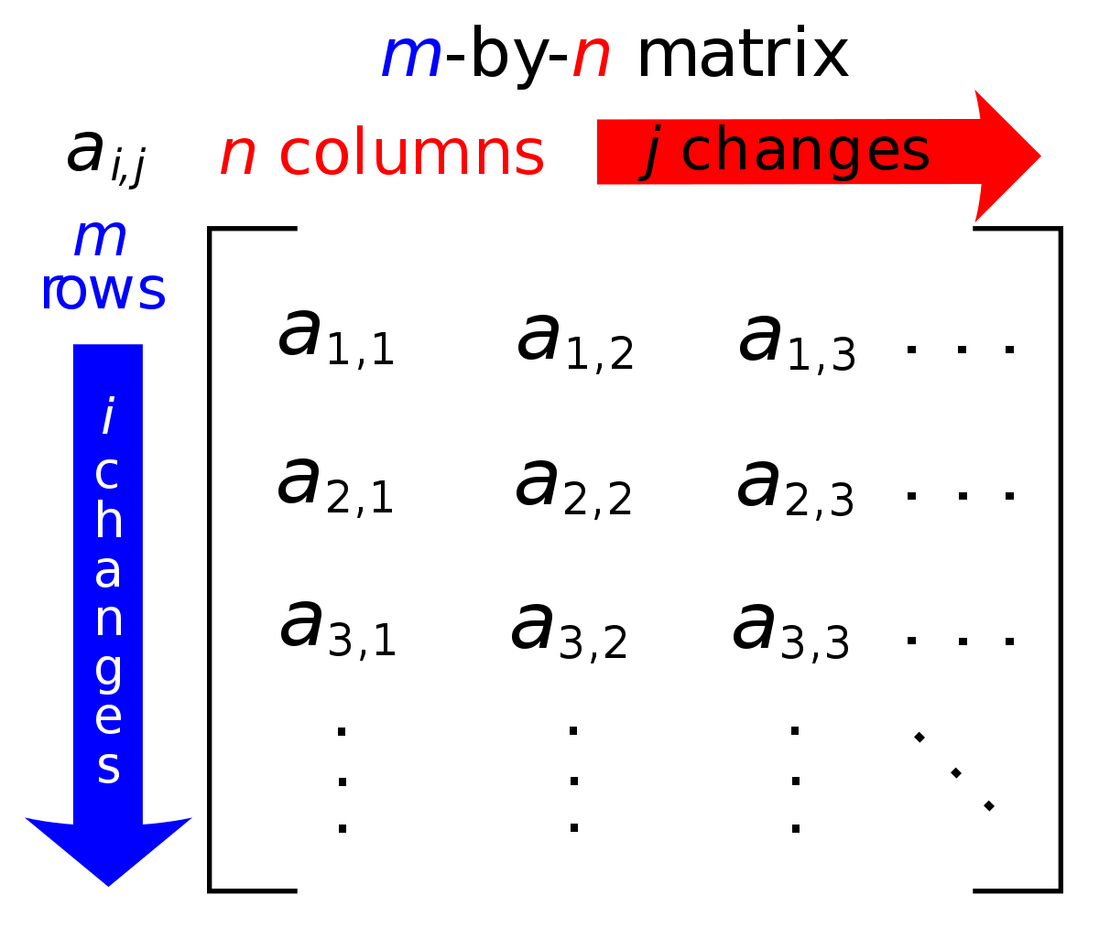
Definition
Matrix, a set of numbers arranged in rows and columns so as to form a rectangular array.
3
Notes:
SAY: Before we wrap up the course, let’s review what we have learned today.
During this course, we have
<READ the bullets from the slide.>
GO to next slide.

Slide 4
Introduction
The numbers are called the elements, or entries, of the matrix. Matrices have wide applications in engineering, physics, economics, and statistics as well as in various branches of mathematics.
Matrices also have important applications in computer graphics, where they have been used to represent rotations and other transformations of images.
4
Notes:
SAY: Before we wrap up the course, let’s review what we have learned today.
During this course, we have
<READ the bullets from the slide.>
GO to next slide.

Slide 5
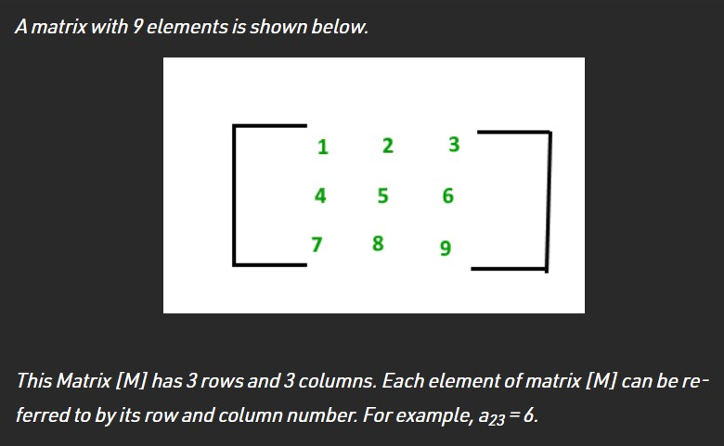
5
Notes:
SAY:
The purpose of epidemiology in public health practice is to
discover the agent, host, and environmental factors that affect health;
determine the relative importance of causes of illness, disability, and death;
identify those segments of the population that have the greatest risk from specific causes of ill health; and
evaluate the effectiveness of health programs and services in improving population health.
GO to next slide.

Slide 6
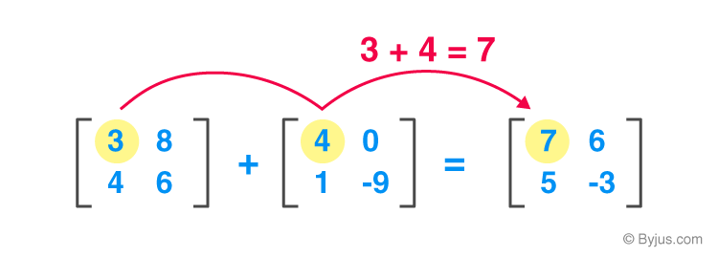
Matrix Operations
Matrix Addition
●●●
6
Notes:
SAY:
The purpose of epidemiology in public health practice is to
discover the agent, host, and environmental factors that affect health;
determine the relative importance of causes of illness, disability, and death;
identify those segments of the population that have the greatest risk from specific causes of ill health; and
evaluate the effectiveness of health programs and services in improving population health.
GO to next slide.

Slide 7
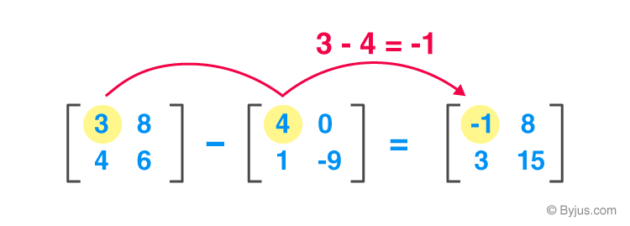
Matrix Operations
Matrix Subtraction
●●●
7
Notes:
SAY:
The purpose of epidemiology in public health practice is to
discover the agent, host, and environmental factors that affect health;
determine the relative importance of causes of illness, disability, and death;
identify those segments of the population that have the greatest risk from specific causes of ill health; and
evaluate the effectiveness of health programs and services in improving population health.
GO to next slide.

Slide 8
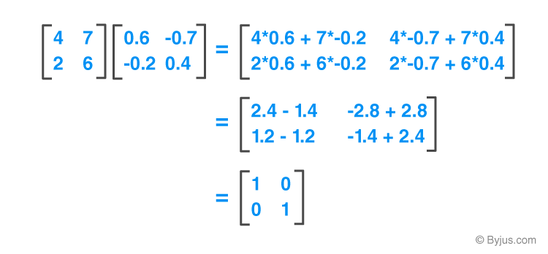
Matrix Operations
Matrix Multiplication
There is a rule for matrix multiplication, the number of columns in the first matrix should be equal to the number of rows in the second.
8
Notes:
SAY:
The purpose of epidemiology in public health practice is to
discover the agent, host, and environmental factors that affect health;
determine the relative importance of causes of illness, disability, and death;
identify those segments of the population that have the greatest risk from specific causes of ill health; and
evaluate the effectiveness of health programs and services in improving population health.
GO to next slide.

Slide 9
Applications of Matrix
Application of Matrices in Cryptography
Cryptography is the process of encrypting data so that only the appropriate individual has access to it and can draw conclusions. The process of encryption is carried out with the help of an invertible key.
●●●
9
Notes:
SAY:
The purpose of epidemiology in public health practice is to
discover the agent, host, and environmental factors that affect health;
determine the relative importance of causes of illness, disability, and death;
identify those segments of the population that have the greatest risk from specific causes of ill health; and
evaluate the effectiveness of health programs and services in improving population health.
GO to next slide.

Slide 10
Applications of Matrix
Application of Matrices in Wireless Communication
Wireless signals are modelled and optimized using matrices. Matrixes are used to detect, extract, and process the information encoded in signals.
The estimation of signals and detecting problems on wireless communication heavily relies on matrices.
●●●
10
Notes:
SAY:
The purpose of epidemiology in public health practice is to
discover the agent, host, and environmental factors that affect health;
determine the relative importance of causes of illness, disability, and death;
identify those segments of the population that have the greatest risk from specific causes of ill health; and
evaluate the effectiveness of health programs and services in improving population health.
GO to next slide.

Slide 11
Applications of Matrix
Application of Matrices in Computer Graphics
A square matrix is a simple way to represent linear object transformations. In the realm of graphics, matrices are used to project three-dimensional images into two-dimensional planes.
●●●
11
Notes:
SAY:
The purpose of epidemiology in public health practice is to
discover the agent, host, and environmental factors that affect health;
determine the relative importance of causes of illness, disability, and death;
identify those segments of the population that have the greatest risk from specific causes of ill health; and
evaluate the effectiveness of health programs and services in improving population health.
GO to next slide.

Slide 12
Applications of Matrix
The application of matrix plays a major role in Mathematics, as well as in other fields. It helps in solving linear equations.
Matrices are extremely valuable objects that can be found in a wide range of applications. The application of matrices in mathematics is used in a wide range of scientific fields as well as mathematical areas.
Engineering mathematics is used in almost every aspect of our lives.
12
Notes:
SAY:
The purpose of epidemiology in public health practice is to
discover the agent, host, and environmental factors that affect health;
determine the relative importance of causes of illness, disability, and death;
identify those segments of the population that have the greatest risk from specific causes of ill health; and
evaluate the effectiveness of health programs and services in improving population health.
GO to next slide.

Slide 13
Types of Matrix
Square Matrix
A square matrix is a matrix where the number of rows (n) equals the number of columns (m).
n = m
The square matrix is contrasted with the rectangular matrix where the number of rows and columns are not equal.
●●●
13
Notes:
SAY:
The purpose of epidemiology in public health practice is to
discover the agent, host, and environmental factors that affect health;
determine the relative importance of causes of illness, disability, and death;
identify those segments of the population that have the greatest risk from specific causes of ill health; and
evaluate the effectiveness of health programs and services in improving population health.
GO to next slide.

Slide 14
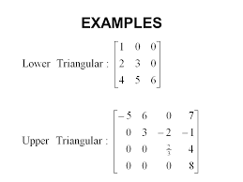

Slide 15
Types of Matrix
Triangular Matrix
A triangular matrix is a type of square matrix that has all values in the upper-right or lower-left of the matrix with the remaining elements filled with zero values.
A triangular matrix with values only above the main diagonal is called an upper triangular matrix. Whereas, a triangular matrix with values only below the main diagonal is called a lower triangular matrix.
●●●
15
Notes:
SAY:
The purpose of epidemiology in public health practice is to
discover the agent, host, and environmental factors that affect health;
determine the relative importance of causes of illness, disability, and death;
identify those segments of the population that have the greatest risk from specific causes of ill health; and
evaluate the effectiveness of health programs and services in improving population health.
GO to next slide.

Slide 16
Types of Matrix
Diagonal Matrix
A diagonal matrix is one where values outside of the main diagonal have a zero value, where the main diagonal is taken from the top left of the matrix to the bottom right.
A diagonal matrix is often denoted with the variable D and may be represented as a full matrix or as a vector of values on the main diagonal.
●●●
16
Notes:
SAY:
The purpose of epidemiology in public health practice is to
discover the agent, host, and environmental factors that affect health;
determine the relative importance of causes of illness, disability, and death;
identify those segments of the population that have the greatest risk from specific causes of ill health; and
evaluate the effectiveness of health programs and services in improving population health.
GO to next slide.

Slide 17
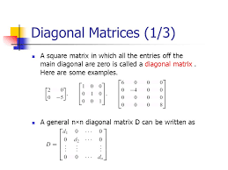

Slide 18
Types of Matrix
Identity Matrix
An identity matrix is a square matrix that does not change a vector when multiplied.
The values of an identity matrix are known. All of the scalar values along the main diagonal (top-left to bottom-right) have the value one, while all other values are zero.
18
Notes:
SAY:
The purpose of epidemiology in public health practice is to
discover the agent, host, and environmental factors that affect health;
determine the relative importance of causes of illness, disability, and death;
identify those segments of the population that have the greatest risk from specific causes of ill health; and
evaluate the effectiveness of health programs and services in improving population health.
GO to next slide.

Slide 19
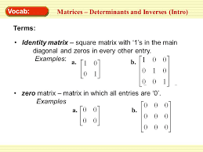

Slide 20
Conclusion
A matrix is a rectangular arrangement of numbers into rows and columns.
Each number in a matrix is referred to as a matrix element or entry. For example, matrix A has 2 rows and 3 columns.
20
Notes:
SAY:
The purpose of epidemiology in public health practice is to
discover the agent, host, and environmental factors that affect health;
determine the relative importance of causes of illness, disability, and death;
identify those segments of the population that have the greatest risk from specific causes of ill health; and
evaluate the effectiveness of health programs and services in improving population health.
GO to next slide.

